Slide 1
Progress Report – Multicontact Capturability
GABRIEL ENRIQUE GARCÍA CHÁVEZ
2019

Slide 2

Full Reduced Inverted Pendulum
Reduced Model of a mechanism:
$$\left\{\begin{aligned}\dot{L}=τ\hat{n}+(r_{p}−r)×f \\ \ddot{r}=\frac{1}{m}f+g \end{aligned}\right.$$

Slide 3

Full Reduced Inverted Pendulum
Using CWC:
$$ζ=\left[\begin{aligned}f \\ τ\end{aligned}\right]$$
$$\left\{\begin{aligned}\dot{L}=τ+(r_{p0}−r)×f \\ \ddot{r}=\frac{1}{m}f+g \end{aligned}\right.,W_{CWC}ζ≤b_{CWC}$$
Use instead
$$L_{2}=L+m(r×\dot{r})$$

Slide 4

Full Reduced Inverted Pendulum
Reduced Model of a mechanism
$$\left\{\begin{aligned}\dot{L}=τ+(r_{p0}−r)×f \\ \ddot{r}=\frac{1}{m}f+g \end{aligned}\right.,W_{CWC}ζ≤b_{CWC}$$
Use instead
$$L_{2}=L+m(r×\dot{r})$$
$${\dot{L}}_{2}=τ+r_{p0}×f+mr×g$$
Affine system!

Slide 5
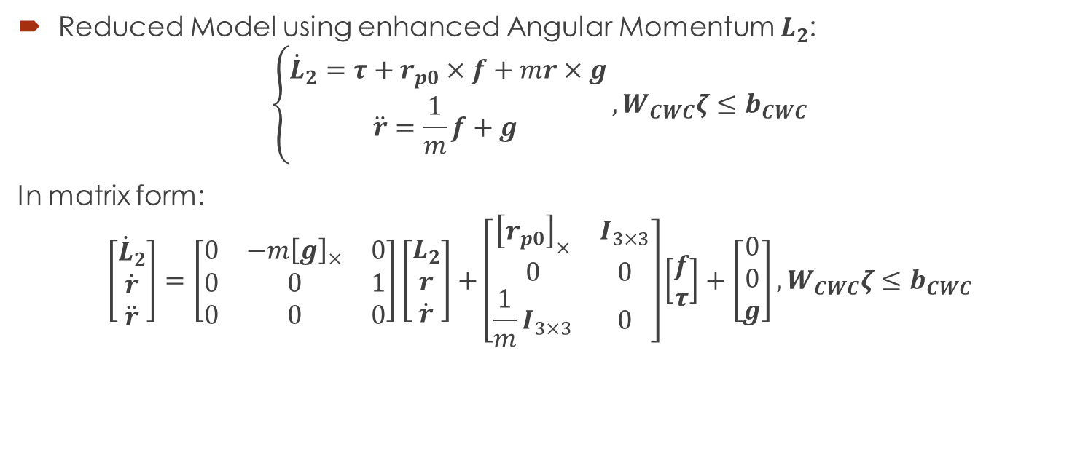
Full Reduced Inverted Pendulum
Reduced Model using enhanced Angular Momentum $L_{2}$:
$$\left\{\begin{aligned}{\dot{L}}_{2}=τ+r_{p0}×f+mr×g \\ \ddot{r}=\frac{1}{m}f+g \end{aligned}\right.,W_{CWC}ζ≤b_{CWC}$$
In matrix form:
$$\left[\begin{aligned}{\dot{L}}_{2} \\ \dot{r} \\ \ddot{r}\end{aligned}\right]=\left[\begin{matrix}0 & −m{\left[g\right]}_{×} & 0 \\ 0 & 0 & 1 \\ 0 & 0 & 0\end{matrix}\right]\left[\begin{aligned}L_{2} \\ r \\ \dot{r}\end{aligned}\right]+\left[\begin{matrix}{\left[r_{p0}\right]}_{×} & I_{3×3} \\ 0 & 0 \\ \frac{1}{m}I_{3×3} & 0\end{matrix}\right]\left[\begin{aligned}f \\ τ\end{aligned}\right]+\left[\begin{aligned}0 \\ 0 \\ g\end{aligned}\right],W_{CWC}ζ≤b_{CWC}$$

Slide 6

Full Reduced Inverted Pendulum
Reduced Model using enhanced Angular Momentum $L_{2}$:
$$\left\{\begin{aligned}{\dot{L}}_{2}=τ+r_{p0}×f+mr×g \\ \ddot{r}=\frac{1}{m}f+g \end{aligned}\right.,W_{CWC}ζ≤b_{CWC}$$
In matrix form:
$$\dot{x}=Ax+Bζ+c,W_{CWC}ζ≤b_{CWC}$$

Slide 7
Full Reduced Inverted Pendulum
Reduced Model using enhanced Angular Momentum $L_{2}$:
$$\left\{\begin{aligned}{\dot{L}}_{2}=τ+r_{p0}×f+mr×g \\ \ddot{r}=\frac{1}{m}f+g \end{aligned}\right.,W_{CWC}ζ≤b_{CWC}$$
In matrix form:
$$\dot{x}=Ax+Bζ+c, W_{CWC}ζ≤b_{CWC}$$

Slide 8
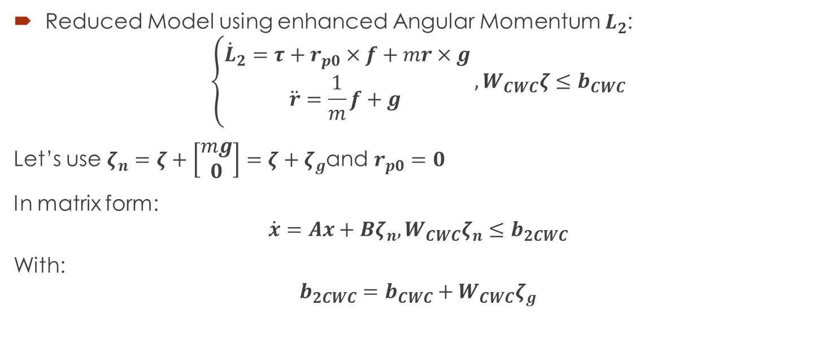
Full Reduced Inverted Pendulum
Reduced Model using enhanced Angular Momentum $L_{2}$:
$$\left\{\begin{aligned}{\dot{L}}_{2}=τ+r_{p0}×f+mr×g \\ \ddot{r}=\frac{1}{m}f+g \end{aligned}\right.,W_{CWC}ζ≤b_{CWC}$$
Let’s use $ζ_{n}=ζ+\left[\begin{aligned}mg \\ 0\end{aligned}\right]=ζ+ζ_{g}$and $r_{p0}=0$
In matrix form:
$$\dot{x}=Ax+Bζ_{n}, W_{CWC}ζ_{n}≤b_{2CWC}$$
With:
$$b_{2CWC}=b_{CWC}+W_{CWC}ζ_{g}$$

Slide 9

Full Reduced Inverted Pendulum
New equivalent linear system:
$$\dot{x}=Ax+Bζ_{n}, W_{CWC}ζ_{n}≤b_{2CWC}$$
Capturability problem:
Find $ζ_{n}=ζ_{n}(x)$ or $ζ_{n}=ζ_{n}\left(t\right)$ holding:
$$x→x_{f}$$
$$ζ_{n}→ζ_{nf}$$
$$x_{f}=\left[\begin{aligned}0 \\ r_{f} \\ 0\end{aligned}\right],ζ_{nf}=\left[\begin{aligned}0 \\ −mr_{f}×g\end{aligned}\right]$$
For some $r_{f}$ in static stability region, i.e.:

Slide 10

Full Reduced Inverted Pendulum
Switch to error space:
$ζ_{ne}=ζ_{n}−ζ_{nf}$, $x_{e}=x−x_{f}$, $b_{3CWC}=b_{2CWC}−W_{CWC}ζ_{nf}$
New equivalent linear system:
$${\dot{x}}_{e}=Ax_{e}+Bζ_{ne}, W_{CWC}ζ_{ne}≤b_{3CWC}$$
Capturability problem:
$$x_{e}→0$$
$$ζ_{ne}→0$$

Slide 11
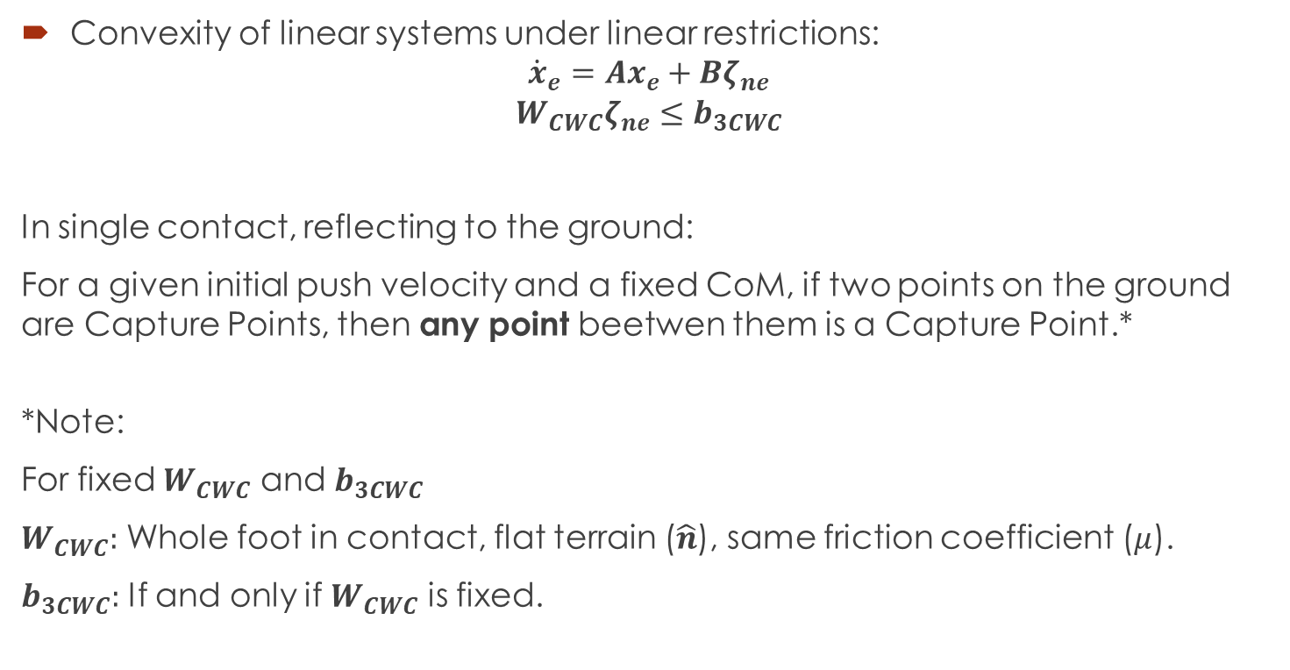
Full Reduced Inverted Pendulum
Convexity of linear systems under linear restrictions:
$${\dot{x}}_{e}=Ax_{e}+Bζ_{ne}$$
$$W_{CWC}ζ_{ne}≤b_{3CWC}$$
In single contact, reflecting to the ground:
For a given initial push velocity and a fixed CoM, if two points on the ground are Capture Points, then any point beetwen them is a Capture Point.*
*Note:
For fixed $W_{CWC}$ and $b_{3CWC}$
$W_{CWC}:$ Whole foot in contact, flat terrain ($\hat{n}$), same friction coefficient ($μ$).
$b_{3CWC}:$ If and only if $W_{CWC}$ is fixed.

Slide 12

Full Reduced Inverted Pendulum
First idea: Optimization:
$$\min_{ζ_{ne}}{\frac{1}{2}\int_{0}^{∞}{x_{e}^{T}Qx_{e}+ζ_{ne}^{T}Rζ_{ne}dt}}$$
Subject to:
$${\dot{x}}_{e}=Ax_{e}+Bζ_{ne}$$
$$W_{CWC}ζ_{ne}≤b_{3CWC}$$
$$x_{e}\left(0\right)=x_{e0}$$
Convex problem!

Slide 13
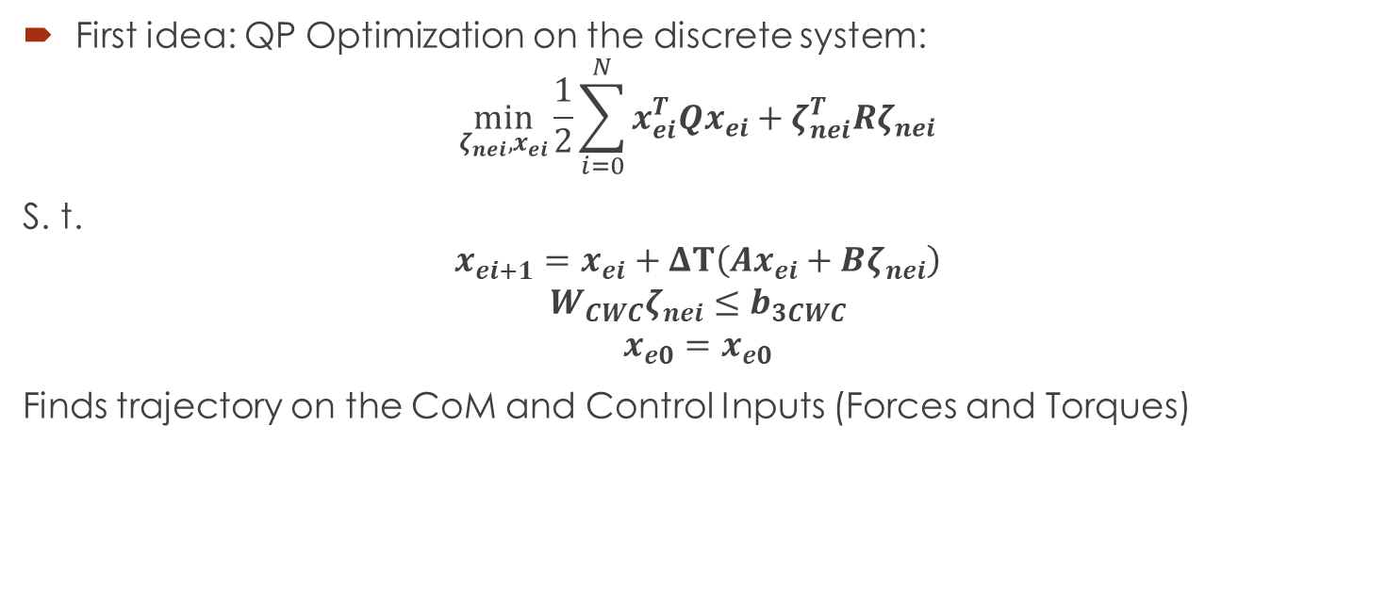
Full Reduced Inverted Pendulum
First idea: QP Optimization on the discrete system:
$$\min_{ζ_{nei}, x_{ei}}{\frac{1}{2}\sum_{i=0}^{N}{x_{ei}^{T}Qx_{ei}+ζ_{nei}^{T}Rζ_{nei}}}$$
S. t.
$$x_{ei+1}=x_{ei}+ΔT\left(Ax_{ei}+Bζ_{nei}\right)$$
$$W_{CWC}ζ_{nei}≤b_{3CWC}$$
$$x_{e0}=x_{e0}$$
Finds trajectory on the CoM and Control Inputs (Forces and Torques)

Slide 14

Full Reduced Inverted Pendulum
Reduced Model of a mechanism:
$$\left\{\begin{aligned}\dot{L}=\sum_{i}{\left(τ_{i}{\hat{n}}_{i}+\left(r_{p0}−r\right)×f_{i}\right)} \\ \ddot{r}=\frac{1}{m}\sum_{i}{f_{i}}+g \end{aligned}\right.$$

Slide 15

Full Reduced Inverted Pendulum
Using CWC on each surface:
$$ζ_{i}=\left[\begin{aligned}f_{i} \\ τ_{i}\end{aligned}\right],ζ_{v}=\left[\begin{aligned}ζ_{1} \\ ⋮ \\ ζ_{n}\end{aligned}\right]$$
$$\left\{\begin{aligned}\dot{L}=\sum_{i}{\left(τ_{i}+\left(r_{p0i}−r\right)×f_{i}\right)} \\ \ddot{r}=\frac{1}{m}\sum_{i}{f_{i}}+g \end{aligned}\right.,W_{CWCi}ζ_{i}≤b_{CWCi},W_{bCWC}ζ_{v}≤b_{bCWC}$$
Use instead
$$f=\sum_{i}{f_{i}}$$
$$τ=\sum_{i}{\left(τ_{i}+\left(r_{p0i}\right)×f_{i}\right)}$$

Slide 16
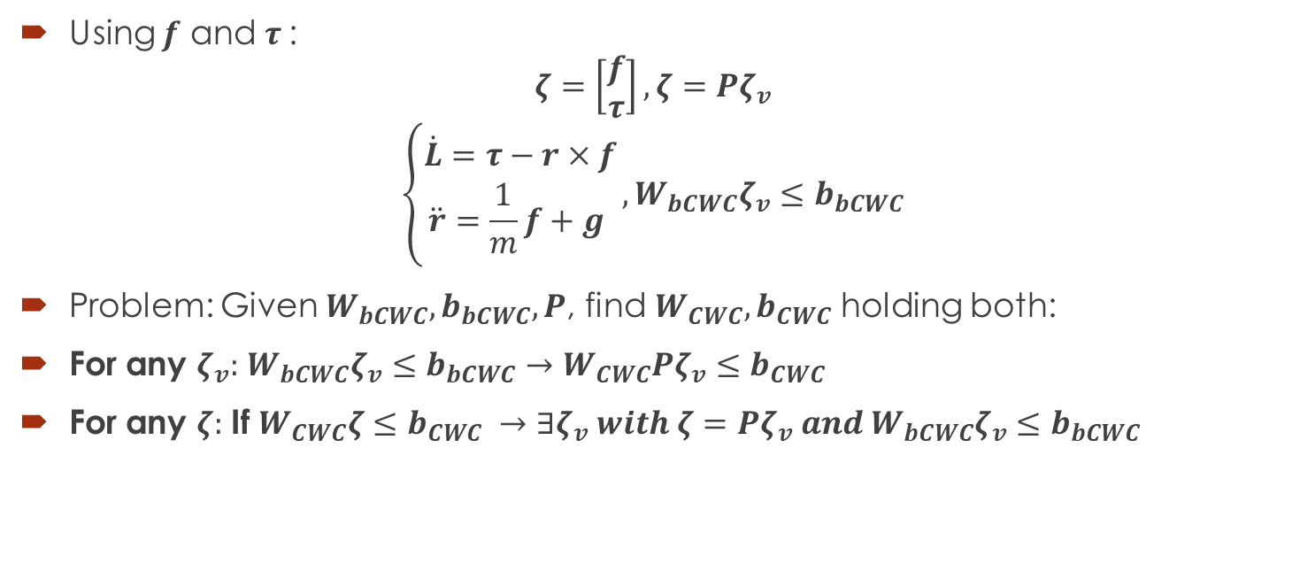
Full Reduced Inverted Pendulum
Using $f$ and $τ$:
$$ζ=\left[\begin{aligned}f \\ τ\end{aligned}\right],ζ=Pζ_{v}$$
$$\left\{\begin{aligned}\dot{L}=τ−r×f \\ \ddot{r}=\frac{1}{m}f+g \end{aligned}\right.,W_{bCWC}ζ_{v}≤b_{bCWC}$$
Problem: Given $W_{bCWC}, b_{bCWC},P$, find $W_{CWC},b_{CWC}$ holding both:
For any $ζ_{v}:$ $W_{bCWC}ζ_{v}≤b_{bCWC}→W_{CWC}Pζ_{v}≤b_{CWC}$
For any $ζ:$ If $W_{CWC}ζ≤b_{CWC} →∃ζ_{v} with ζ=Pζ_{v} and W_{bCWC}ζ_{v}≤b_{bCWC}$

Slide 17
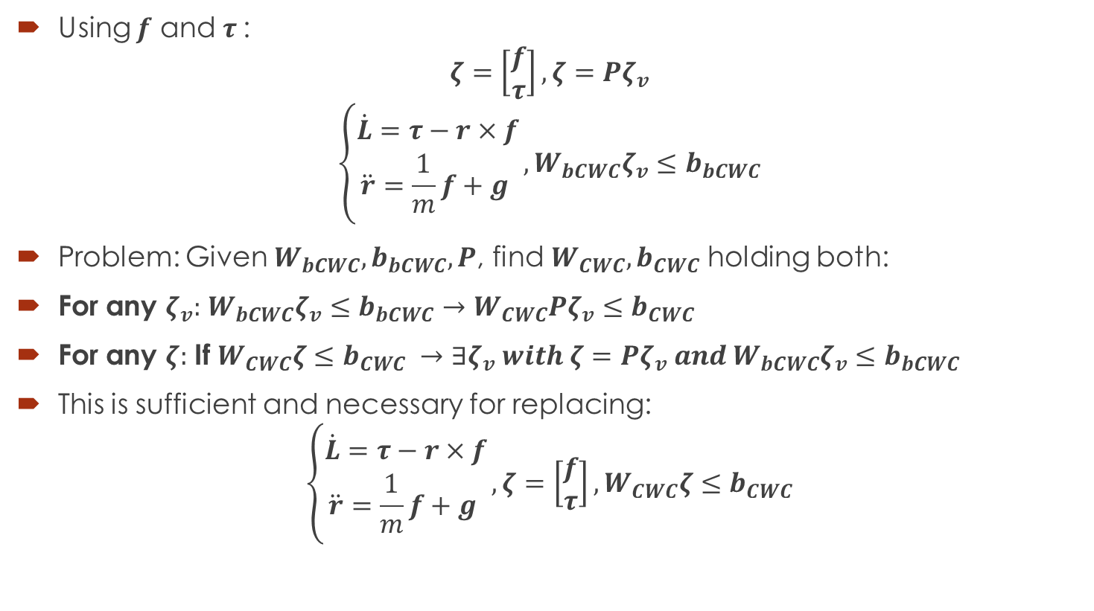
Full Reduced Inverted Pendulum
Using $f$ and $τ$:
$$ζ=\left[\begin{aligned}f \\ τ\end{aligned}\right],ζ=Pζ_{v}$$
$$\left\{\begin{aligned}\dot{L}=τ−r×f \\ \ddot{r}=\frac{1}{m}f+g \end{aligned}\right.,W_{bCWC}ζ_{v}≤b_{bCWC}$$
Problem: Given $W_{bCWC}, b_{bCWC},P$, find $W_{CWC},b_{CWC}$ holding both:
For any $ζ_{v}:$ $W_{bCWC}ζ_{v}≤b_{bCWC}→W_{CWC}Pζ_{v}≤b_{CWC}$
For any $ζ:$ If $W_{CWC}ζ≤b_{CWC} →∃ζ_{v} with ζ=Pζ_{v} and W_{bCWC}ζ_{v}≤b_{bCWC}$
This is sufficient and necessary for replacing:
$$\left\{\begin{aligned}\dot{L}=τ−r×f \\ \ddot{r}=\frac{1}{m}f+g \end{aligned}\right.,ζ=\left[\begin{aligned}f \\ τ\end{aligned}\right],W_{CWC}ζ≤b_{CWC}$$

Slide 18
Full Reduced Inverted Pendulum
Using $f$ and $τ$:
$$ζ=\left[\begin{aligned}f \\ τ\end{aligned}\right],ζ=Pζ_{v}$$
$$\left\{\begin{aligned}\dot{L}=τ−r×f \\ \ddot{r}=\frac{1}{m}f+g \end{aligned}\right.,W_{bCWC}ζ_{v}≤b_{bCWC}$$
Problem: Given $W_{bCWC}, b_{bCWC},P$, find $W_{CWC},b_{CWC}$ holding both:
For any $ζ_{v}:$ $W_{bCWC}ζ_{v}≤b_{bCWC}→W_{CWC}Pζ_{v}≤b_{CWC}$
For any $ζ:$ If $W_{CWC}ζ≤b_{CWC} →∃ζ_{v} with ζ=Pζ_{v} and W_{bCWC}ζ_{v}≤b_{bCWC}$
This is sufficient and necessary for replacing:
$$\left\{\begin{aligned}\dot{L}=τ−r×f \\ \ddot{r}=\frac{1}{m}f+g \end{aligned}\right.,ζ=\left[\begin{aligned}f \\ τ\end{aligned}\right],W_{CWC}ζ≤b_{CWC}$$

Slide 19

Full Reduced Inverted Pendulum
Problem: Given $W_{bCWC}, b_{bCWC},P$, find $W_{CWC},b_{CWC}$ holding both:
For any $ζ_{v}:$ $W_{bCWC}ζ_{v}≤b_{bCWC}→W_{CWC}Pζ_{v}≤b_{CWC}$
For any $ζ:$ If $W_{CWC}ζ≤b_{CWC} →∃ζ_{v} with ζ=Pζ_{v} and W_{bCWC}ζ_{v}≤b_{bCWC}$
Linear projection problem!

Slide 20
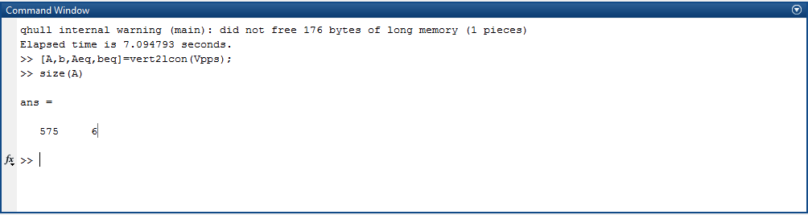

Full Reduced Inverted Pendulum
Problem: Given $W_{bCWC}, b_{bCWC},P$, find $W_{CWC},b_{CWC}$ holding both:
For any $ζ_{v}:$ $W_{bCWC}ζ_{v}≤b_{bCWC}→W_{CWC}Pζ_{v}≤b_{CWC}$
For any $ζ:$ If $W_{CWC}ζ≤b_{CWC} →∃ζ_{v} with ζ=Pζ_{v} and W_{bCWC}ζ_{v}≤b_{bCWC}$

Slide 21

Full Reduced Inverted Pendulum
In $ζ_{v}$:
$$ζ_{i}=\left[\begin{aligned}f_{i} \\ τ_{i}\end{aligned}\right],ζ_{v}=\left[\begin{aligned}ζ_{1} \\ ⋮ \\ ζ_{n}\end{aligned}\right]$$
$$\left\{\begin{aligned}\dot{L}=\sum_{i}{\left(τ_{i}+\left(r_{p0i}−r\right)×f_{i}\right)} \\ \ddot{r}=\frac{1}{m}\sum_{i}{f_{i}}+g \end{aligned}\right.,W_{bCWC}ζ_{v}≤b_{bCWC}$$
Use instead
$$L_{2}=L+m(r×\dot{r})$$

Slide 22

Full Reduced Inverted Pendulum
Using $L_{2}$:
$$ζ_{i}=\left[\begin{aligned}f_{i} \\ τ_{i}\end{aligned}\right],ζ_{v}=\left[\begin{aligned}ζ_{1} \\ ⋮ \\ ζ_{n}\end{aligned}\right]$$
$$\left\{\begin{aligned}{\dot{L}}_{2}=\sum_{i}{τ_{i}}+{\left[r_{p0i}\right]}_{×}\sum_{i}{f_{i}}+mr×g \\ \ddot{r}=\frac{1}{m}\sum_{i}{f_{i}}+g \end{aligned}\right.,W_{bCWC}ζ_{v}≤b_{bCWC}$$

Slide 23
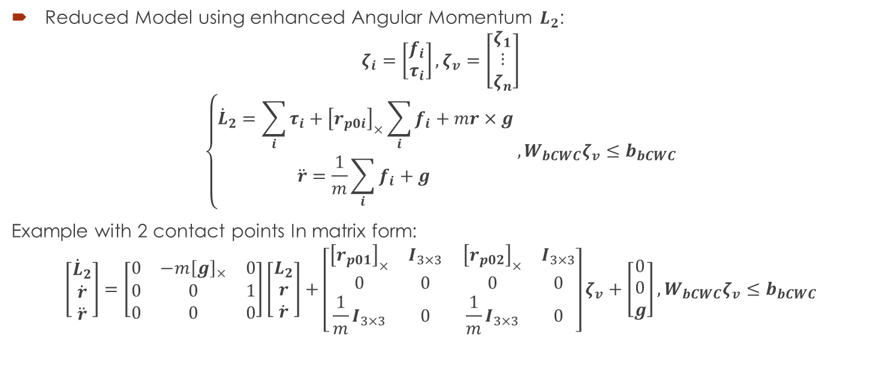
Full Reduced Inverted Pendulum
Reduced Model using enhanced Angular Momentum $L_{2}$:
$$ζ_{i}=\left[\begin{aligned}f_{i} \\ τ_{i}\end{aligned}\right],ζ_{v}=\left[\begin{aligned}ζ_{1} \\ ⋮ \\ ζ_{n}\end{aligned}\right]$$
$$\left\{\begin{aligned}{\dot{L}}_{2}=\sum_{i}{τ_{i}}+{\left[r_{p0i}\right]}_{×}\sum_{i}{f_{i}}+mr×g \\ \ddot{r}=\frac{1}{m}\sum_{i}{f_{i}}+g \end{aligned}\right.,W_{bCWC}ζ_{v}≤b_{bCWC}$$
Example with 2 contact points In matrix form:
$$\left[\begin{aligned}{\dot{L}}_{2} \\ \dot{r} \\ \ddot{r}\end{aligned}\right]=\left[\begin{matrix}0 & −m{\left[g\right]}_{×} & 0 \\ 0 & 0 & 1 \\ 0 & 0 & 0\end{matrix}\right]\left[\begin{aligned}L_{2} \\ r \\ \dot{r}\end{aligned}\right]+\left[\begin{matrix}{\left[r_{p01}\right]}_{×} & I_{3×3} \\ 0 & 0 \\ \frac{1}{m}I_{3×3} & 0\end{matrix} \begin{matrix}{\left[r_{p02}\right]}_{×} & I_{3×3} \\ 0 & 0 \\ \frac{1}{m}I_{3×3} & 0\end{matrix}\right]ζ_{v}+\left[\begin{aligned}0 \\ 0 \\ g\end{aligned}\right],W_{bCWC}ζ_{v}≤b_{bCWC}$$

Slide 24
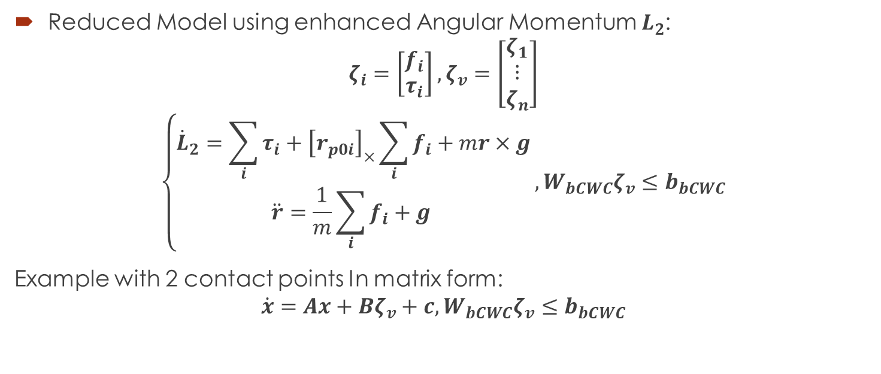
Full Reduced Inverted Pendulum
Reduced Model using enhanced Angular Momentum $L_{2}$:
$$ζ_{i}=\left[\begin{aligned}f_{i} \\ τ_{i}\end{aligned}\right],ζ_{v}=\left[\begin{aligned}ζ_{1} \\ ⋮ \\ ζ_{n}\end{aligned}\right]$$
$$\left\{\begin{aligned}{\dot{L}}_{2}=\sum_{i}{τ_{i}}+{\left[r_{p0i}\right]}_{×}\sum_{i}{f_{i}}+mr×g \\ \ddot{r}=\frac{1}{m}\sum_{i}{f_{i}}+g \end{aligned}\right.,W_{bCWC}ζ_{v}≤b_{bCWC}$$
Example with 2 contact points In matrix form:
$$\dot{x}=Ax+Bζ_{v}+c,W_{bCWC}ζ_{v}≤b_{bCWC}$$

Slide 25
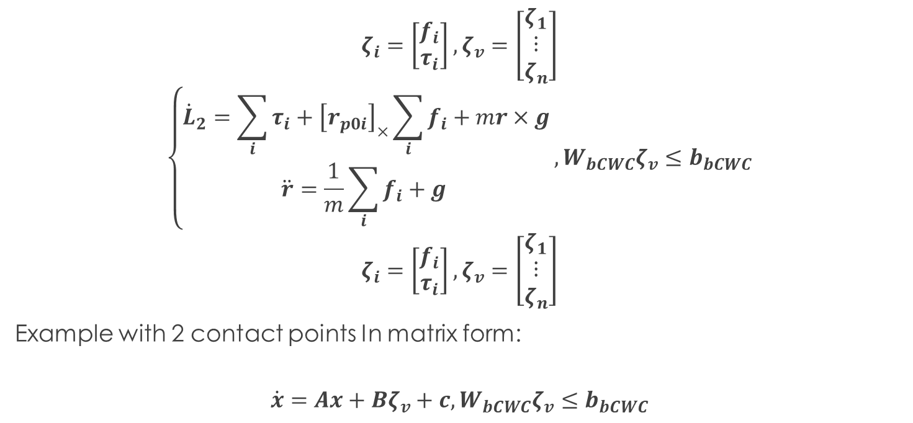
Full Reduced Inverted Pendulum
$$ζ_{i}=\left[\begin{aligned}f_{i} \\ τ_{i}\end{aligned}\right],ζ_{v}=\left[\begin{aligned}ζ_{1} \\ ⋮ \\ ζ_{n}\end{aligned}\right]$$
$$\left\{\begin{aligned}{\dot{L}}_{2}=\sum_{i}{τ_{i}}+{\left[r_{p0i}\right]}_{×}\sum_{i}{f_{i}}+mr×g \\ \ddot{r}=\frac{1}{m}\sum_{i}{f_{i}}+g \end{aligned}\right.,W_{bCWC}ζ_{v}≤b_{bCWC}$$
$$ζ_{i}=\left[\begin{aligned}f_{i} \\ τ_{i}\end{aligned}\right],ζ_{v}=\left[\begin{aligned}ζ_{1} \\ ⋮ \\ ζ_{n}\end{aligned}\right]$$
Example with 2 contact points In matrix form:
$$\dot{x}=Ax+Bζ_{v}+c,W_{bCWC}ζ_{v}≤b_{bCWC}$$

Slide 26
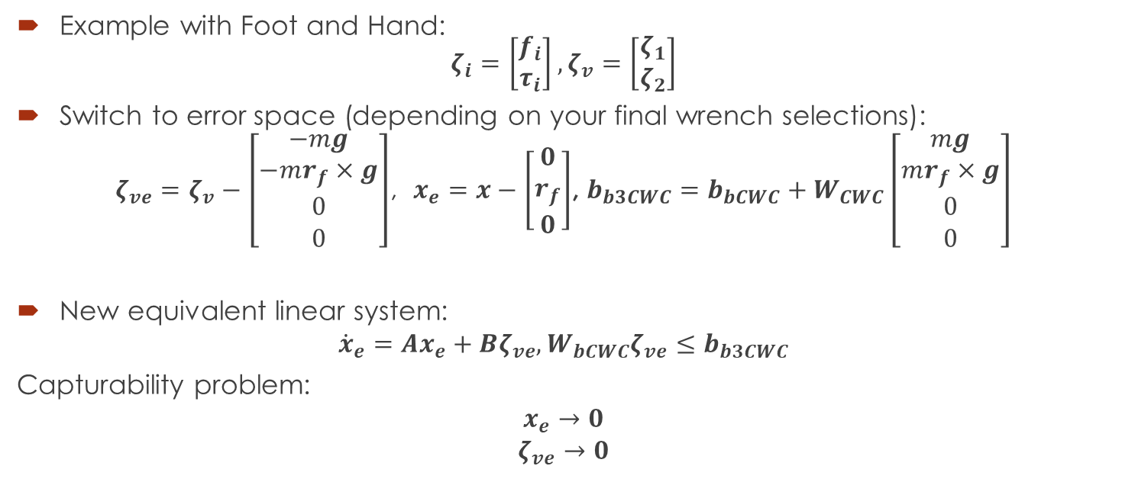
Full Reduced Inverted Pendulum
Example with Foot and Hand: $ζ_{i}=\left[\begin{aligned}f_{i} \\ τ_{i}\end{aligned}\right],ζ_{v}=\left[\begin{aligned}ζ_{1} \\ ζ_{2}\end{aligned}\right]$
Switch to error space (depending on your final wrench selections):
$ζ_{ve}=ζ_{v}−\left[\begin{aligned}−mg \\ −mr_{f}×g \\ 0 \\ 0\end{aligned}\right]$, $x_{e}=x−\left[\begin{aligned}0 \\ r_{f} \\ 0\end{aligned}\right]$, $b_{b3CWC}=b_{bCWC}+W_{CWC}\left[\begin{aligned}mg \\ mr_{f}×g \\ 0 \\ 0\end{aligned}\right]$
New equivalent linear system:
$${\dot{x}}_{e}=Ax_{e}+Bζ_{ve}, W_{bCWC}ζ_{ve}≤b_{b3CWC}$$
Capturability problem:
$$x_{e}→0$$
$$ζ_{ve}→0$$

Slide 27

Full Reduced Inverted Pendulum
First idea: Optimization:
$$\min_{ζ_{ne}}{\frac{1}{2}\int_{0}^{∞}{x_{e}^{T}Qx_{e}+ζ_{ne}^{T}Rζ_{ne}dt}}$$
Subject to:
$${\dot{x}}_{e}=Ax_{e}+Bζ_{ne}$$
$$W_{bCWC}ζ_{ve}≤b_{b3CWC}$$
$$x_{e}\left(0\right)=x_{e0}$$
Convex problem!

Slide 28
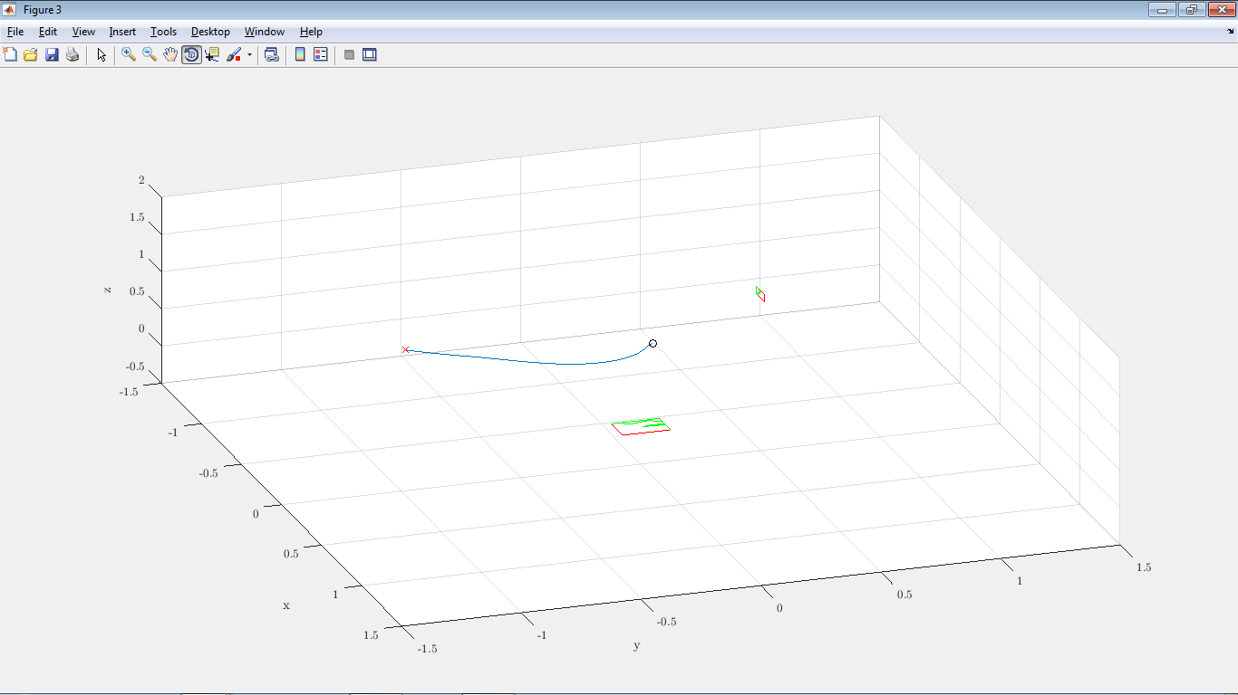
Full Reduced Inverted Pendulum
First idea: QP Optimization on the discrete system:

Slide 29
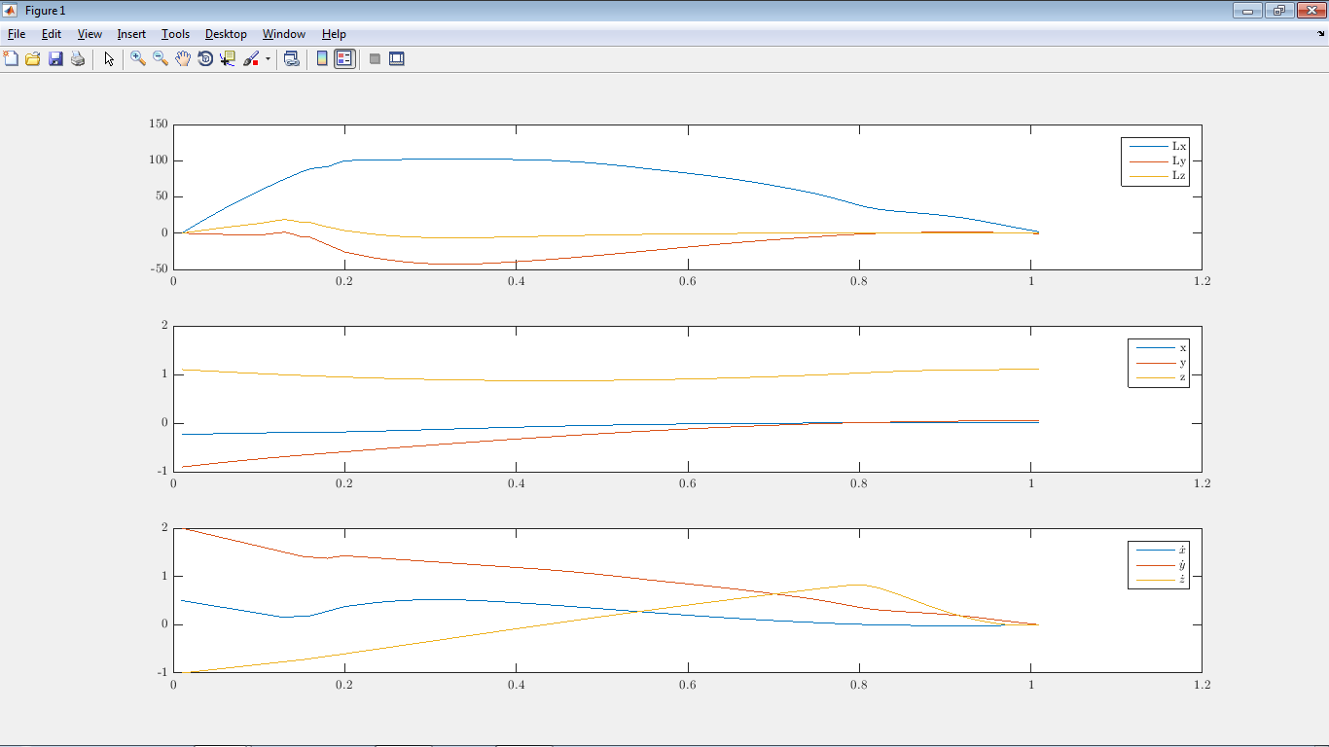
Full Reduced Inverted Pendulum
First idea: QP Optimization on the discrete system:

Slide 30
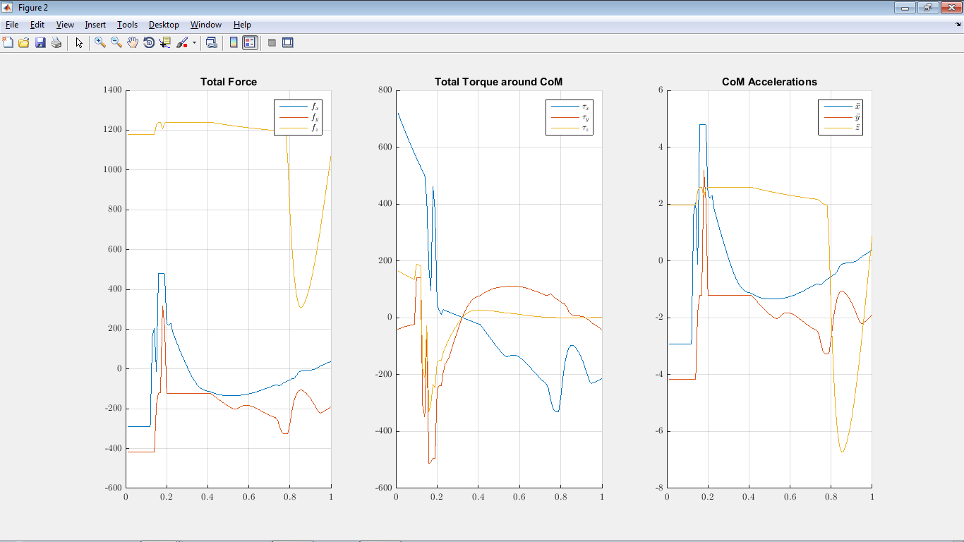
Full Reduced Inverted Pendulum
First idea: QP Optimization on the discrete system:

Slide 31
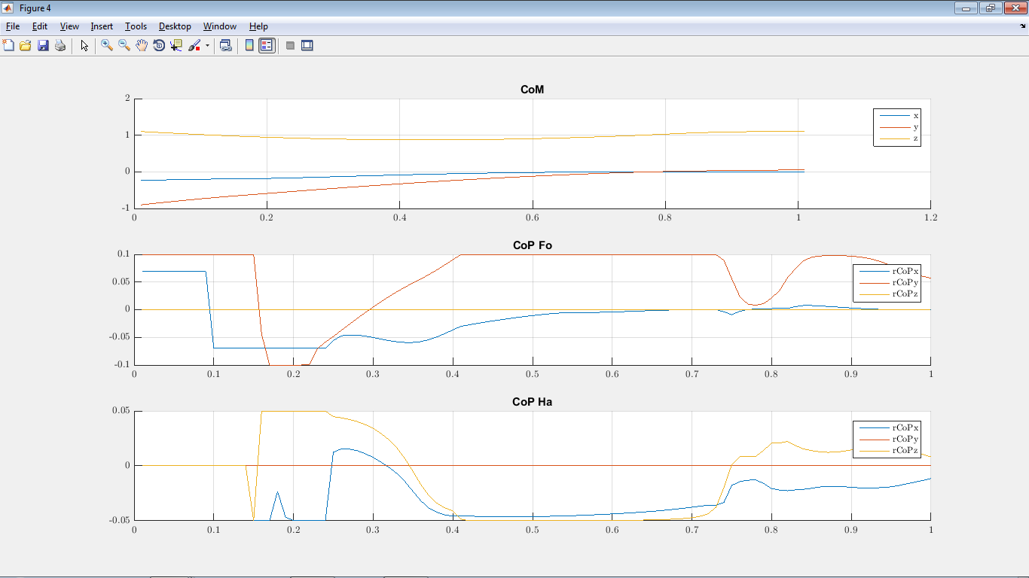
Full Reduced Inverted Pendulum
First idea: QP Optimization on the discrete system:

Slide 32
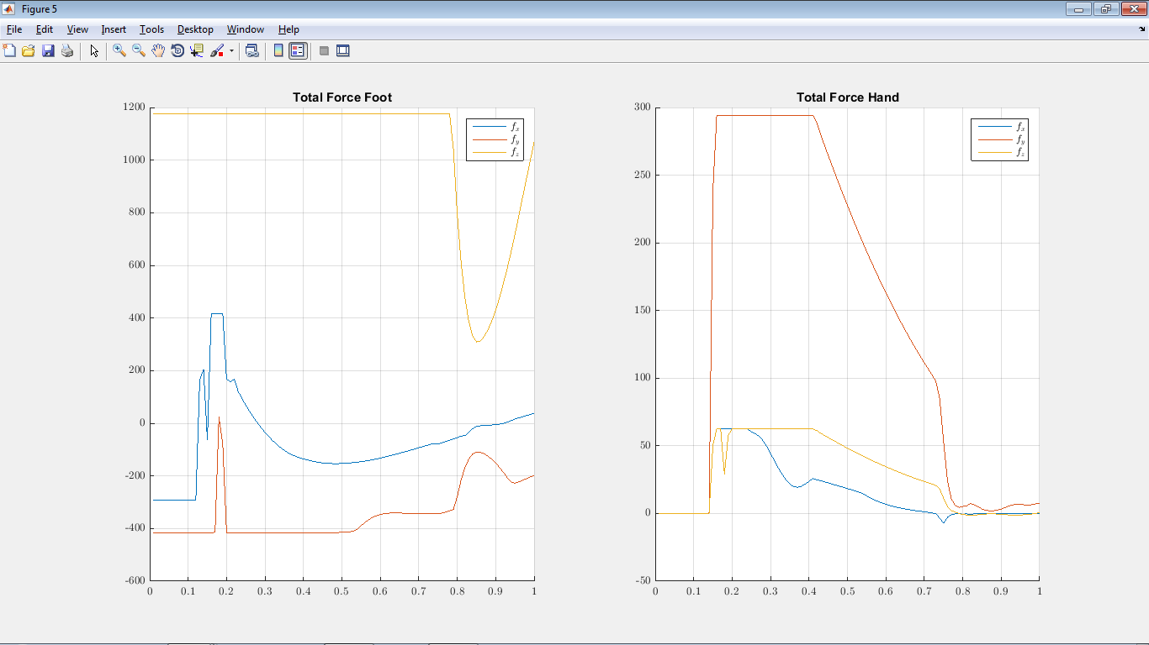
Full Reduced Inverted Pendulum
First idea: QP Optimization on the discrete system:

Slide 33







LP for finding CoMs
Finding allowed CoMs for a fixed CWC (and fixed ${\dot{r}}_{0},L_{0}$): LP program:
1. Pick a random $r_{CoM0}$ (Stabilizable, example: a point on the static stability).
2. Pick a random ${\hat{v}}_{j}$. Can be defined by two angles (2D, i.e. angles from spherical coordinates).
3.$\max_{r_{CoM1},ζ_{nei},x_{ei}}\left(r_{CoM1}−r_{CoM0}\right)∙{\hat{v}}_{j}$ s.t
$$W_{CWC}ζ_{nei}≤b_{3CWC}$$
$$x_{ei+1}=x_{ei}+ΔT\left(Ax_{ei}+Bζ_{nei}\right)$$
$$x_{eN}=x_{ef}$$
$$x_{e0}=\left[\begin{aligned}L_{0}+m(r_{CoM1}×{\dot{r}}_{0}) \\ r_{CoM1}−r_{f} \\ {\dot{r}}_{0}\end{aligned}\right]$$
$$r_{CoM0}$$
$$r_{CoM1}$$
$${\hat{v}}_{j}$$
$${\hat{v}}_{j}$$
$$ζ$$

Slide 34
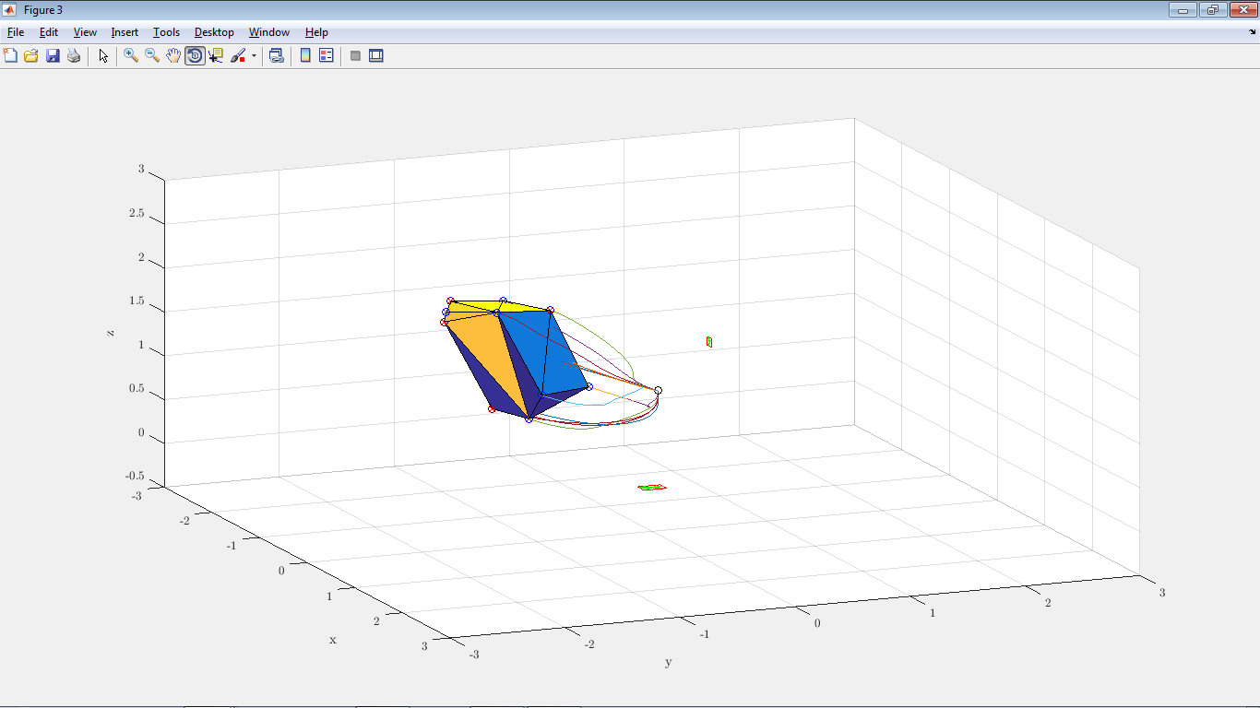
LP for finding CoMs
Finding allowed CoMs for a fixed CWC (and fixed ${\dot{r}}_{0},L_{0}$): LP program:

Slide 35
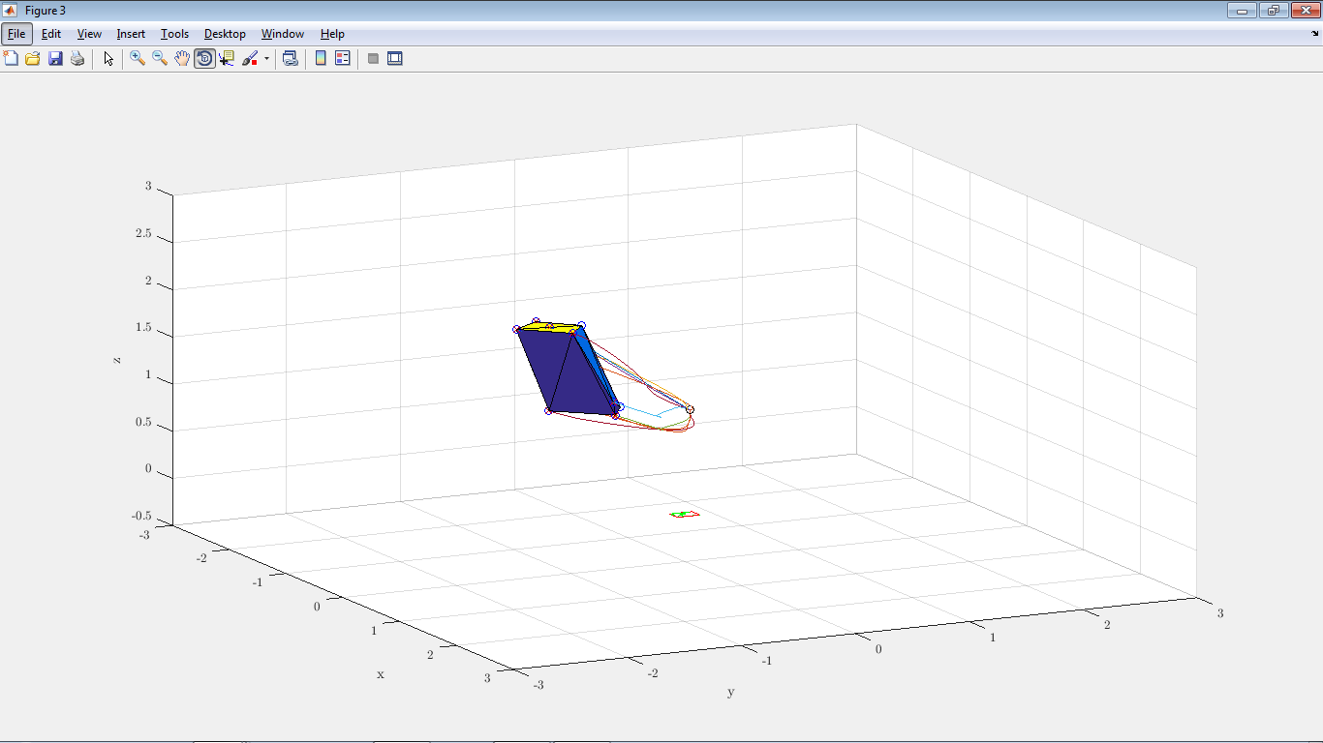
LP for finding CoMs
Without hand:

Slide 36
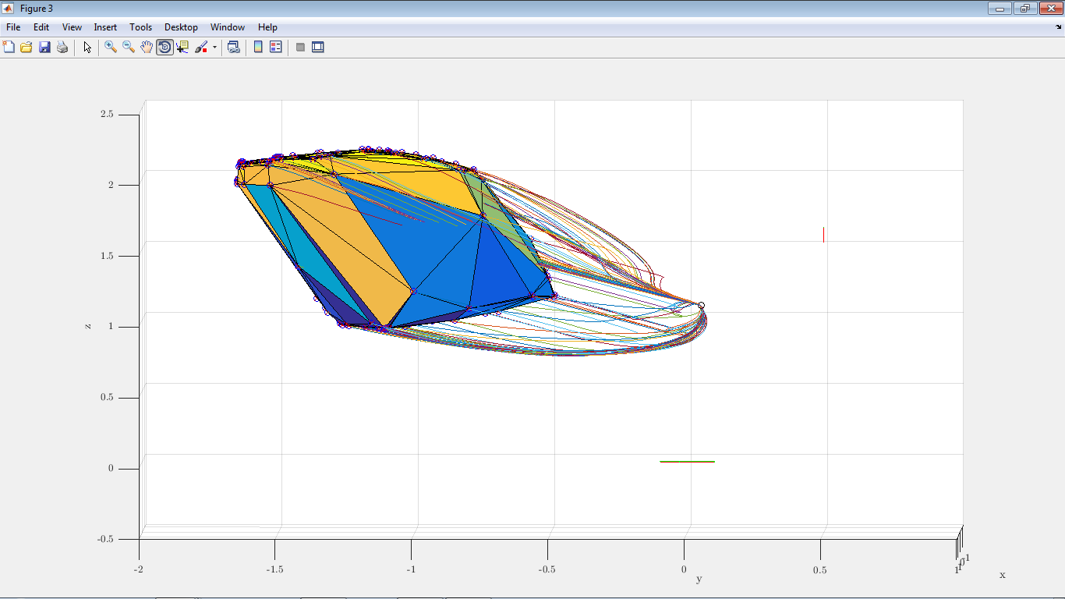
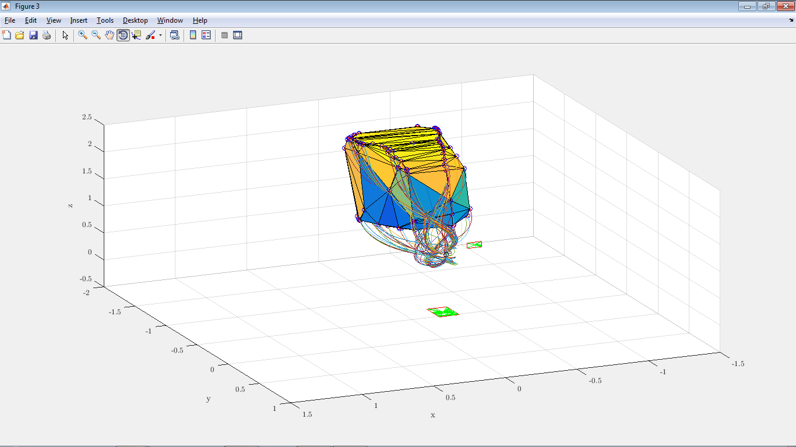
LP for finding CoMs
Finding allowed CoMs for a fixed CWC (and fixed ${\dot{r}}_{0},L_{0}$): LP program:

Slide 37
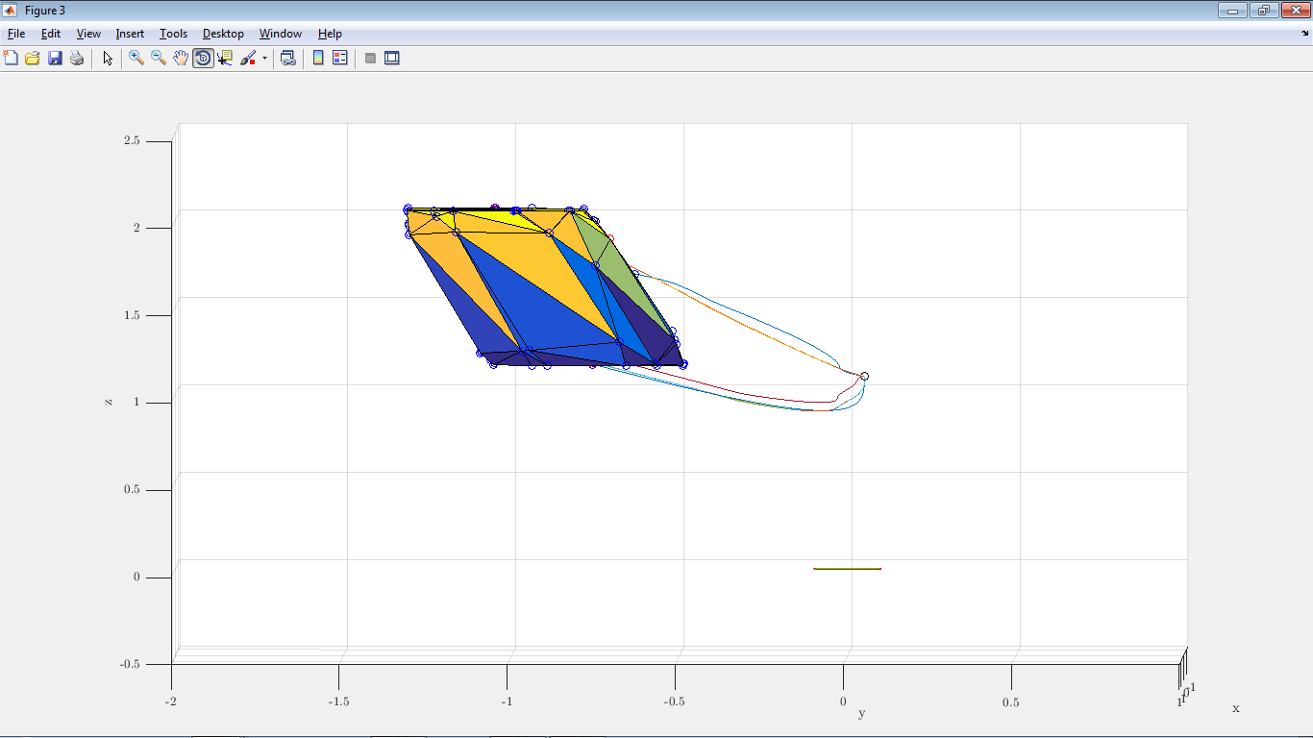
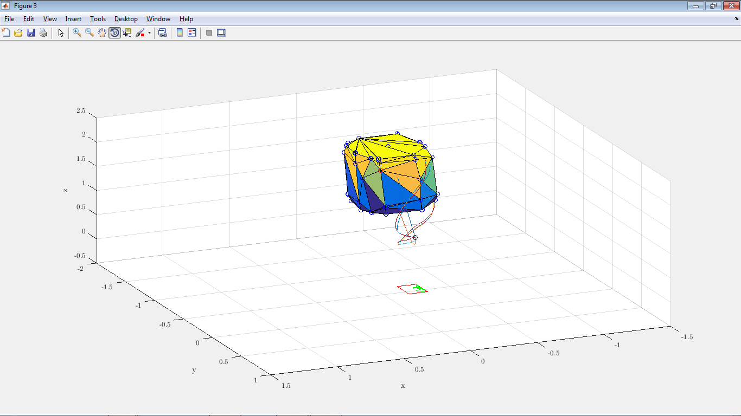
LP for finding CoMs
Without hand:

Slide 38
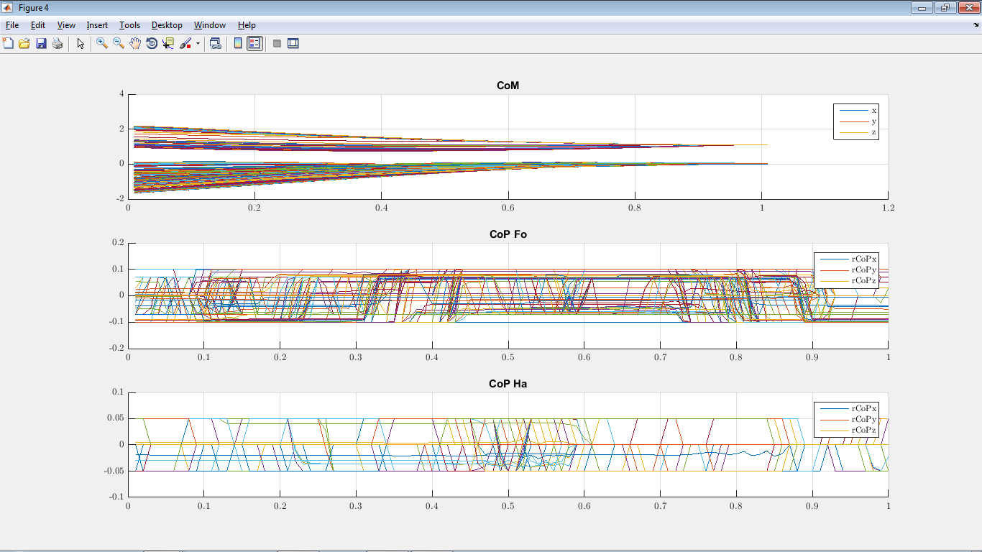
LP for finding CoMs
Finding allowed CoMs for a fixed CWC (and fixed ${\dot{r}}_{0},L_{0}$): LP program:

Slide 39
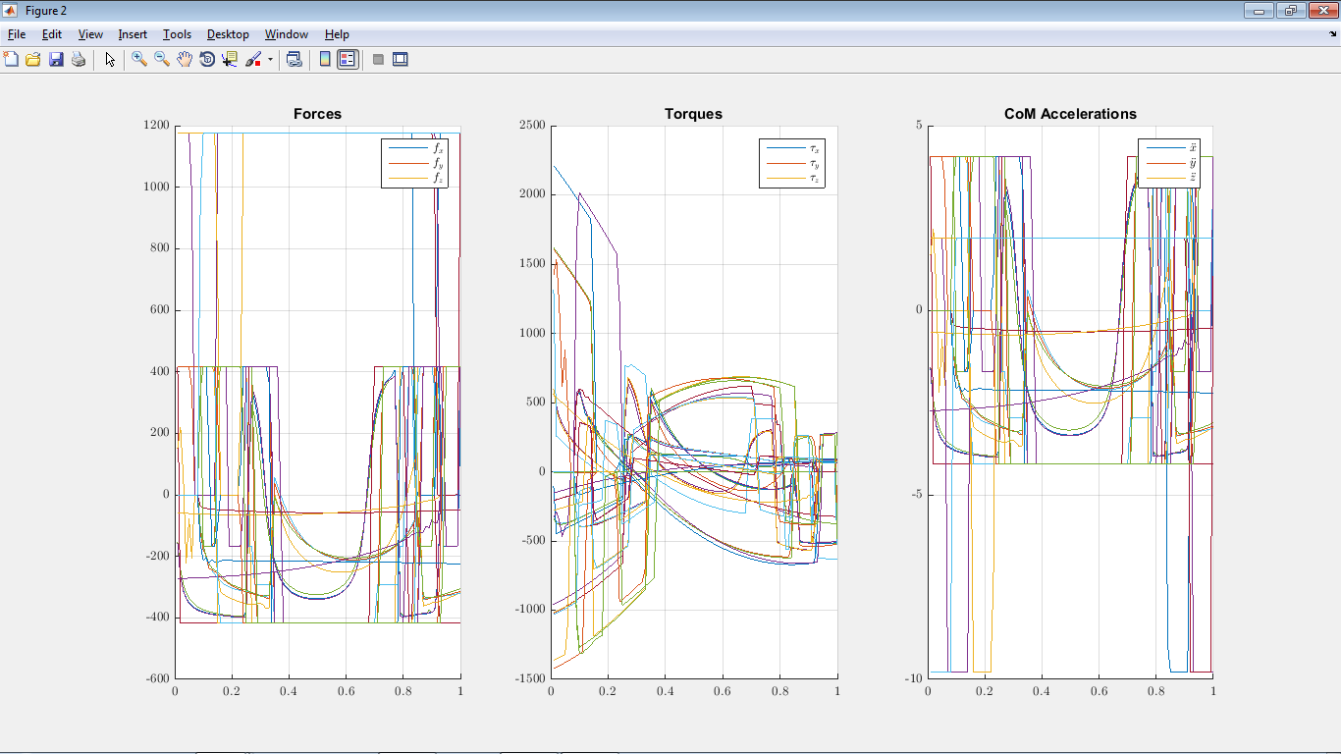
LP for finding CoMs
Finding allowed CoMs for a fixed CWC (and fixed ${\dot{r}}_{0},L_{0}$): LP program:

